Slide 1

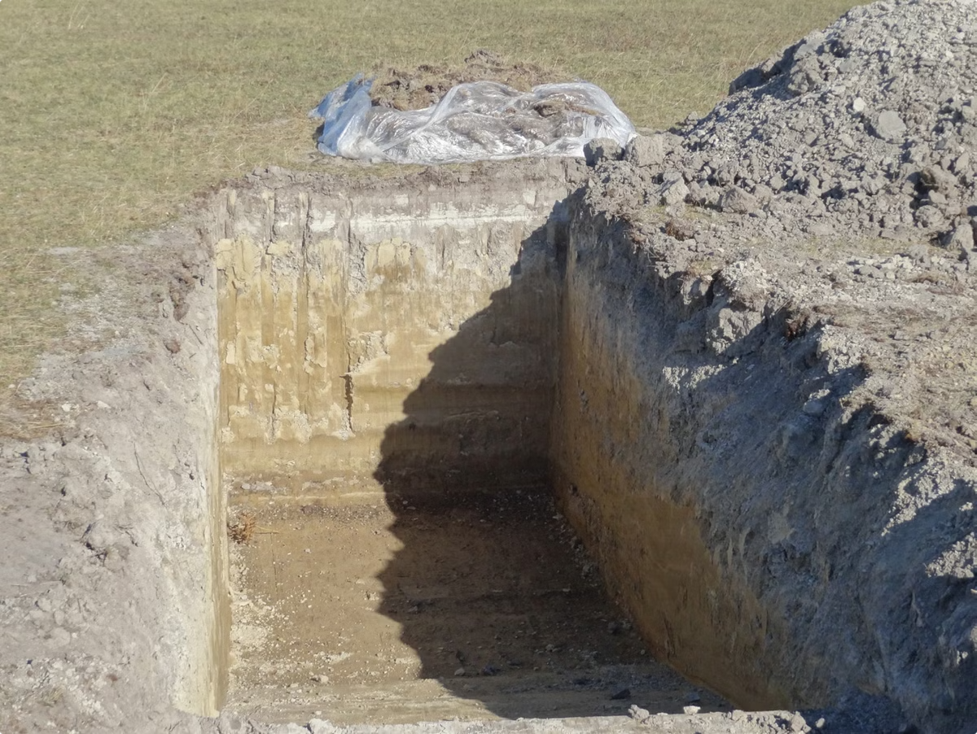
The Causes of Water Logging and Salinity
Presented by ,
Name -Manoranjan sarkar
St. Code : BWU/LLB/24/037
Program name – LLB
Course name - Environmental studies
Course code-LLB102
Section -A Sem-1st

Slide 2

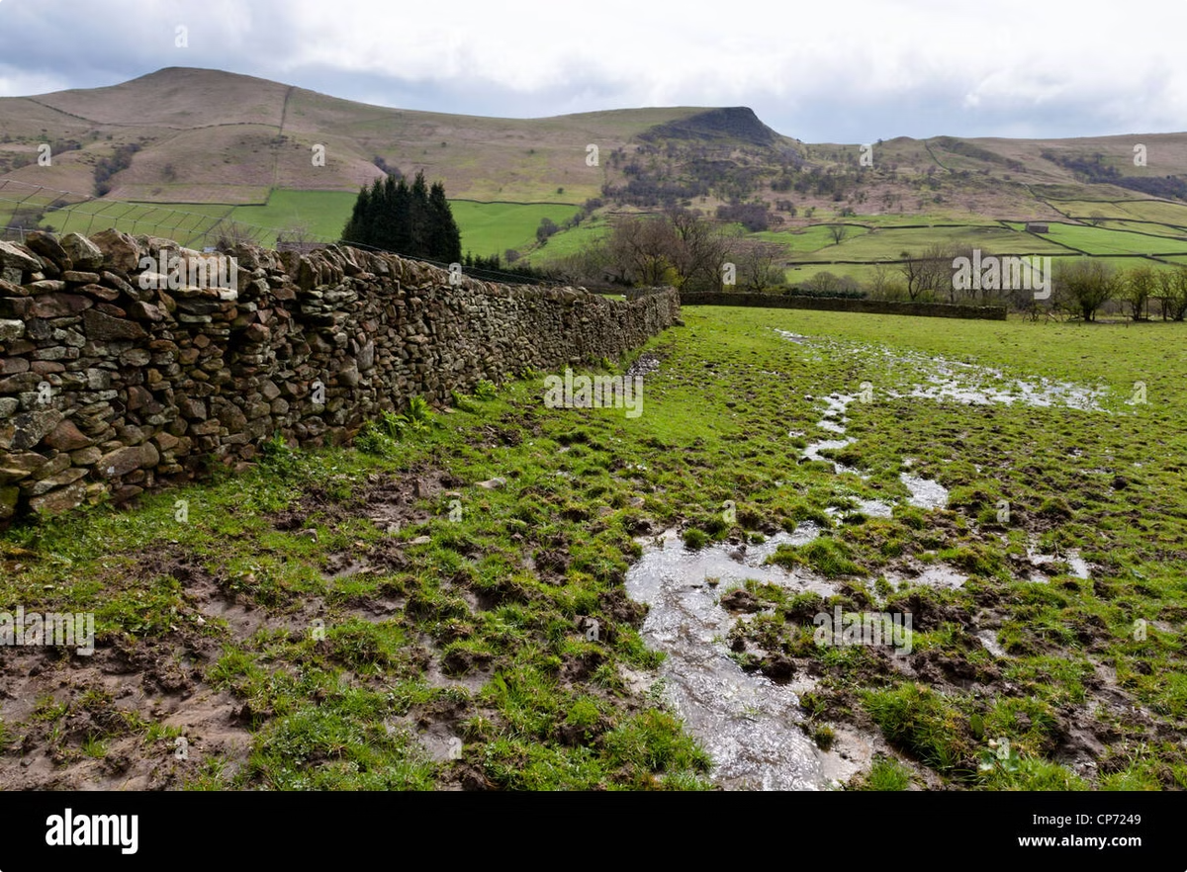
Introduction to Water Logging and Salinity
1
Water Logging
2
Salinity
Occurs when the soil becomes saturated with water, leading to oxygen deprivation for plant roots.
Excessive salt accumulation in the soil, making it difficult for plants to absorb water.
3
Combined Impact
Water logging often contributes to salinity by hindering drainage and promoting salt build-up.

Slide 3

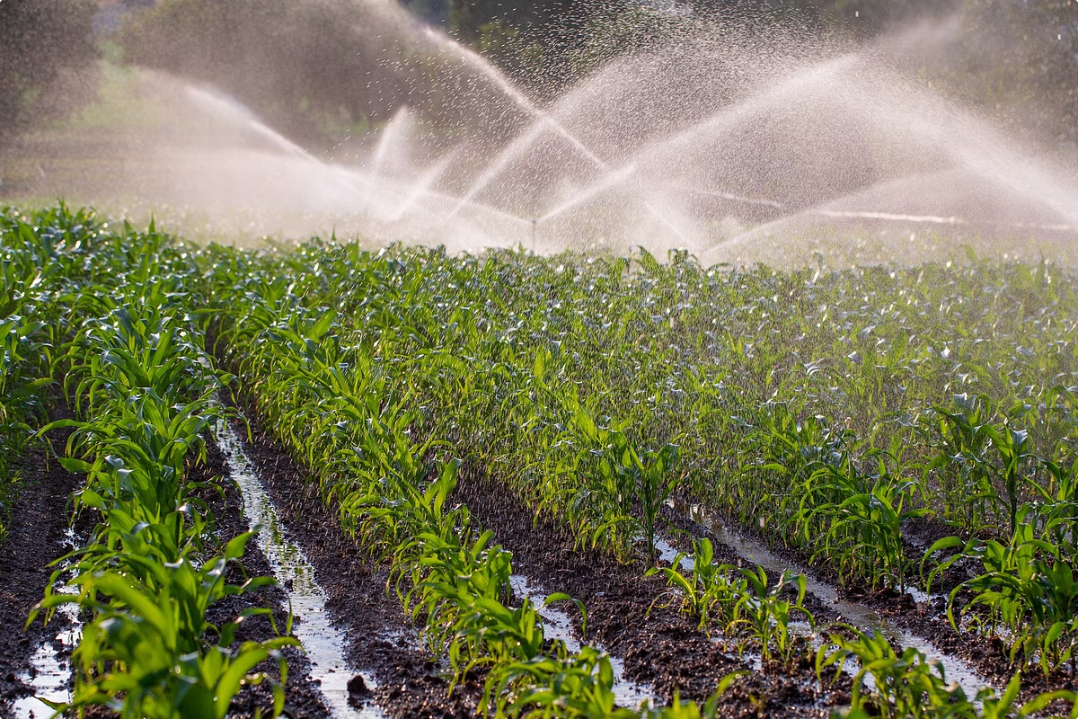
Inadequate Drainage Systems
1
Poor Infrastructure
Inadequate drainage canals and ditches prevent water from draining efficiently.
2
Clogging and Blockages
Accumulation of debris or sediment can hinder drainage flow and contribute to water logging.
3
Insufficient Slope
Flat landscapes may not allow for natural drainage, requiring artificial drainage systems.

Slide 4
Excessive Irrigation Practices
Over-Watering
Improper Timing
Inconsistent Application
Applying excessive water to crops can lead to saturation and water logging.
Irrigating during periods of high rainfall can further exacerbate water logging conditions.
Uneven irrigation can lead to areas of excess water and contribute to salinity.

Slide 5


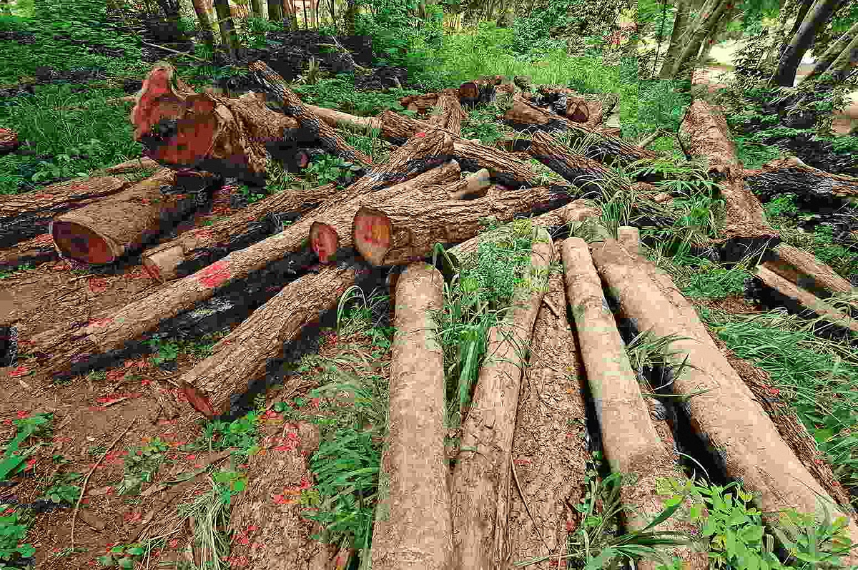


Deforestation and Land Use Changes
Loss of Vegetation
Removing trees reduces water absorption and infiltration.
Soil Erosion
Deforestation exposes soil to erosion, leading to sedimentation in drainage systems.
Increased Runoff
Reduced vegetation cover increases surface runoff, potentially carrying salts into agricultural fields.

Slide 6

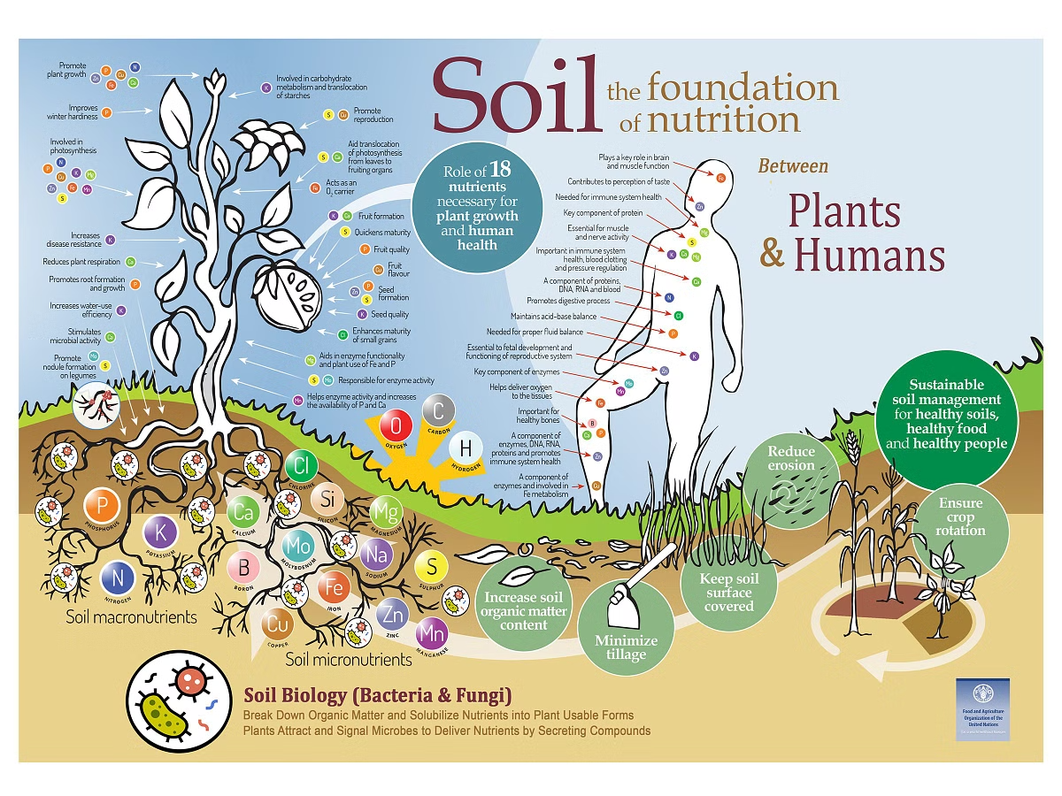
Improper Soil Management
Poor Soil Structure
Compacted soil reduces water infiltration and drainage.
Low Organic Matter
Decreased organic matter content limits soil's ability to retain water and nutrients.
Lack of Soil Amendments
Failure to use gypsum or other amendments can exacerbate salinity issues.

Slide 7


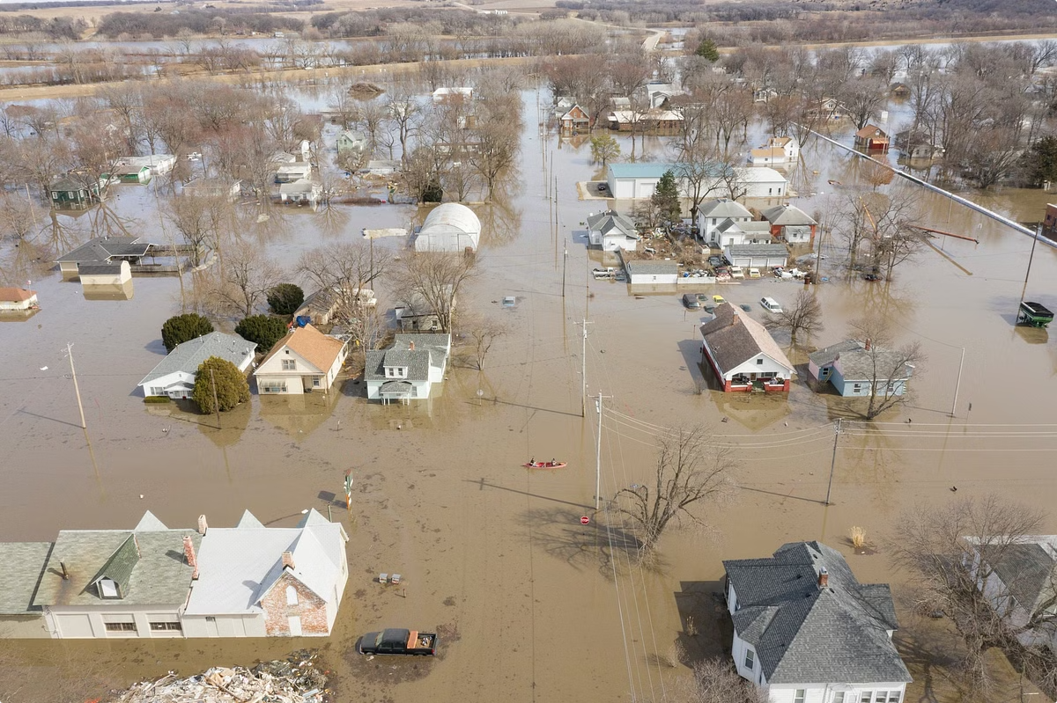


Impact of Climate Change
Increased Rainfall
Heavy rainfall can overwhelm drainage systems and lead to water logging.
Drought Periods
Droughts can lead to increased irrigation demands, potentially leading to water logging.
Rising Temperatures
Higher temperatures increase evaporation, concentrating salts in the soil.

Slide 8

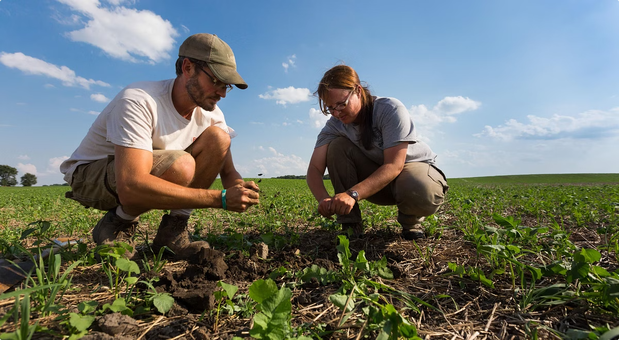
Potential Solutions and Mitigation Strategies
Improved Drainage Systems
Water Conservation Practices
Investing in efficient drainage canals and ditches to improve water removal.
Adopting irrigation techniques that minimize water use and prevent over-watering.
Reforestation and Afforestation
Soil Health Management
Implementing practices that improve soil structure and organic matter content.
Restoring vegetation cover to enhance water infiltration and reduce runoff.

Slide 9


